Slide 1
Considerations in selecting an automotive engine for conversion. Presented by Stuart Davis of

Slide 2
ISSUES YOU HAVE TO CONSIDER Propeller Restrictions Engine Selection & Performance Gear Ratio’s and Types of Drives Fuel and Oil Chemistry FAA Requirements Questions and Answers

Slide 3
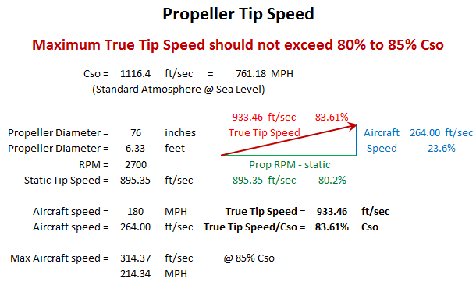
PROPELLER RESTRICTIONS

Slide 4
ENGINE SELECTION
1) Choose a previously converted and proven engine, like a VW, Corvair, or Chevy V8. Find out what has worked and what has not worked for you airframe and goals.
2) Use your favorite engine, but watch for;
a) Cost of maintenance parts
b) Aftermarket parts and support – performance and heavy
duty parts, electronics - is it possible to get the EFI and/or
ECU reprogrammed?
Is there a known service history, and will there be long term support for the engine.
4) Are you falling into the BUBA J trap over an engine?

Slide 5
ENGINE PERFORMANCE
Must be compatible with Propeller Limitation
Dyno Chart for Horsepower and Torque RPM ranges
Need a gear ratio to get from Propeller to Engine RPM’s
For GM LS V8 engines the BW350 gear ratio is 1.667:1
RPM limit for stock GM crate engines is 6000 RPM.
Safe continuous RPM at 75% of limit is 4500 RPM.
4500 RPM / 1.667 = 2700 RPM
Which engines look good at 2500 to 4500 RPM?
5.7L to 6.2L LS V8’s replace IO-540 and IO=550
The 4.3L V-6 will make a good alternative for the IO-360 and IO-390.

Slide 6
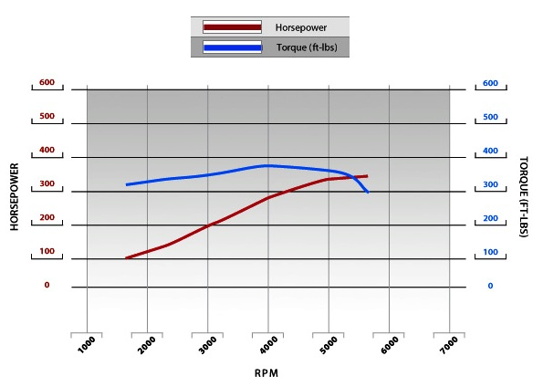
LS1 5.7L DYNO CHART
4500 RPM = 310 HP & 375 (380 peak) Torque $5,924

Slide 7
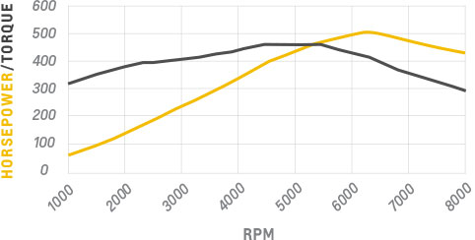
LS7 7.0L DYNO
4500 RPM = 396 HP & 460 Torque vs 310/375
* about 45# heavier and $17,129 more

Slide 8
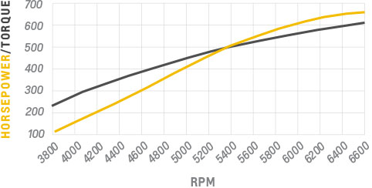
LS9 6.2L SC DYNO
4500 RPM = 290 HP & 380 Torque $26,010

Slide 9
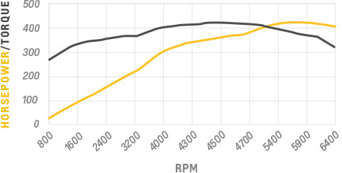
LS3 6.2L DYNO
4500 RPM = 367 HP & 427 Torque vs 310/375
SRP = $7,761

Slide 10
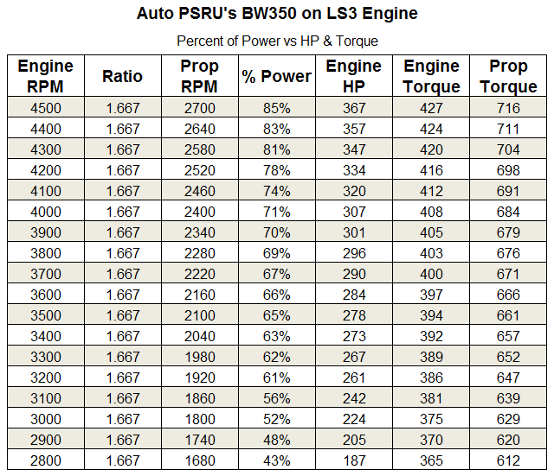
LS3 ENGINE TO PROP POWER
Cruise

Slide 11
GEAR RATIOS / TYPES OF DRIVES
Two basic types of drives – Geared and Belted
Belted Drives
1) Are lighter but are limited to about 250 HP
2) Don’t support constant speed propellers
3) Gear ratios typically are 1.43 thru 3.00 to 1
Geared Drives
1) Are heavier but handle 200 HP and up
2) Required lubrications system can easily
support constant speed propellers
3) Gear ratios typically are 1.23thru 3.53 to 1
Both have vibration dampening challenges.

Slide 12
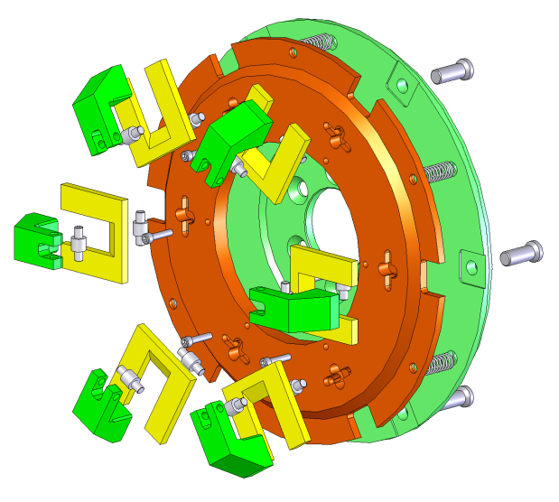
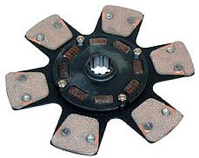
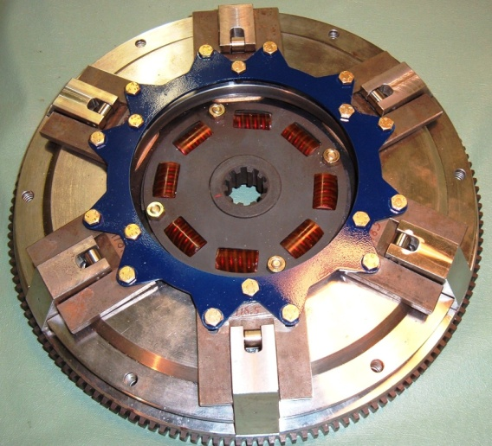
GEAR RATIOS / TYPES OF DRIVES
Vibration Dampening
Auto PSRU’s uses this design on both the 200Z and BW350

Slide 13
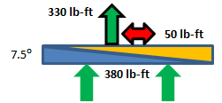
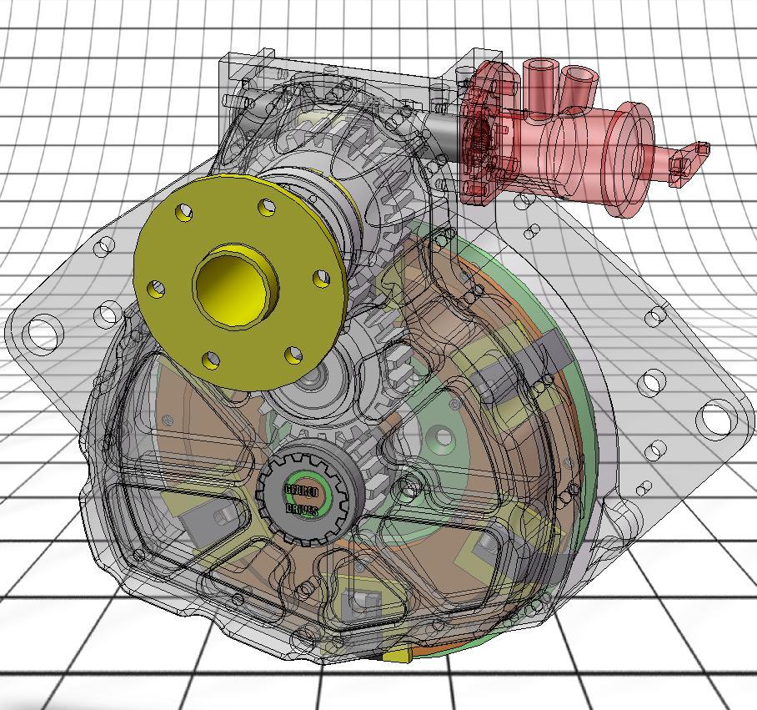
BW350 Gear Box
PSRU for Chevrolet LS series engines, V8, V6, I4
400+ Horsepower
Clutch engages/disengages at about 900 RPM
Straight cut gears – more efficient, reduced loads
Uses automatic clutch and dynamic damper
Much lighter loads on starter
Eliminates Propeller Kick-back
Independent lubrication system
Gear Ratio 1.667:1 (fixed – due to shaft spacing)
WEIGHTS:
Gear Box = 63 lbs
(w/o prop gov., about 2 lbs)
Clutch Assy = 37 lbs
Lubricant = 4 lbs
TOTAL = 106 lbs

Slide 14
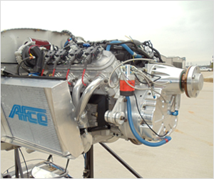
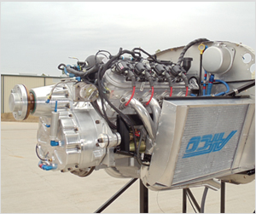
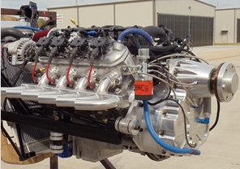
Fire Wall Forward Comparisons
FWF weights vary depending on the aircraft installation due to motor mounts, radiator installations, cowling mods, arrangement of accessories, type of exhaust, etc.
On the Glasair III the LS1 FWF installation weighed just under 30 lbs less.
On the Raven 500 with the LS1 weighing 22 lbs less.
(less propellers and cowlings)
ADVANTAGES
1) Costs; purchase and maintenance.
2) Cabin Heat; through a water heater eliminates carbon monoxide.
3) Alternators; 85 - 205 amp on the LS1 vs 35 - 65 amp on an IO-540.
OPTIONS FOR THE WEIGHT SAVINGS
1) Factory A/C that runs off the engine rather than off the electrical system.
2) Add an engine pre-oiler system,
3) Electrical systems; a backup alternator, a backup battery.

Slide 15
Why The Buzz Over Crate Engines?
#1 – Insurance companies at first did not offer insurance for the first 40 Hours Phase 1 flight testing unless it is a factory built engine. Positive experience is starting to relax some of these requirements. Check with your insurance and/or compare requirements.
#2 – Some factory crate engines are not intended to be operated continuously under the higher load conditions we subject them to. Selecting the correct one with stronger connecting rods and crankshafts is important.
#3 – These engines are different and have some unique requirements for assembling one correctly. There are several good books and videos on how to do it. Done correctly a wide variety of stronger parts and even better dyno performance curves are possible.

Slide 16
RADIATOR SIZING
Basic minimum size calculation for any water cooled engine is 1.2 times the Horse Power of the engine equals the radiator area in square inches.
350 HP engine x 1.2 = 420 sq in core area (dual row core).
Dual radiators = 420 / 2 = 210 sq in core area for each radiator.
Dual radiators requires a header tank mounted higher than the radiators in addition to an overflow collection tank.
Adding extra rows of cooling tubes to a radiator core does not increase the cooling capacity of the radiator in a linear fashion.
If you start with a 120 sq in single row core a 60 sq in dual row core will not
cool as well, and a 40 sq in 3 row core will cool even less.
Each additional row reduces the total air flow threw the core due to
increased aerodynamic drag.
Pure water does conduct heat better than water mixed with antifreeze. The advantage of is to lower the freeze pint, it does help to raise the boiling point slightly, but most importantly it prevents corrosion and lubricates the water pump bearings and seal.

Slide 17
INTAKE INDUCTION REQUIREMENTS
Quoted from the GM installation manual for crate engines.
• Ensure the MAF sensor is oriented correctly in the induction (it will only read correctly in the proper direction). An arrow is located on the sensor indicating correct flow direction. Verify this before welding the mounting boss, as the sensor will mount only one way in the boss.
• Ensure the MAF Sensor is mounted in the middle of a minimum 6 inch length of 4 inch diameter tube, and is a minimum of 10 inches from the throttle body.
All current GM crate engines use a MAF Sensor between the air filter and the throttle body. The MAF Sensor accuracy is greatly effected by any turbulence before and after the sensor. The changing position of the throttle body valve plate will cause the pressure wave ahead of the throttle body to change location up and down the tube.
The extra 4 inches in total tube length can include the elbow fitting.

Slide 18
INTAKE INDUCTION REQUIREMENTS
Minimum 6” Straight Section
4”
Tube
To Air Filter
Air Flow
Minimum 10” From Throttle Body
UP

Slide 19
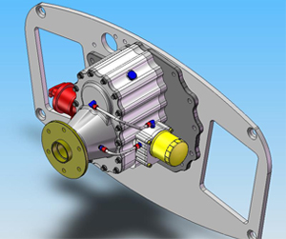
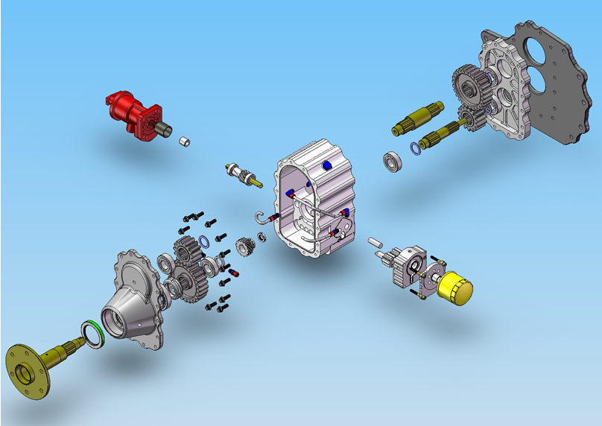
200Z Gear Box
PSRU for engines 100 to 300 Horsepower
Clutch engages/disengages at about 900 RPM
Straight cut gears – more efficient, reduced loads
Uses automatic clutch and dynamic damper
Independent lubrication system
Much lighter loads on starter
Eliminates Propeller Kick-back
Gear Ratios of 1.506:1 to 3.529:1
(std shaft spacing & 2 sets of gears)
WEIGHTS:
Gear Box = 39 lbs
(w/o prop gov., about 2 lbs)
Clutch Assy = 28 lbs
Lubricant = 3 lbs
TOTAL = 70 lbs
2 lbs less than Eggenfellner

Slide 20
200Z INSTALLATIONS
The 2.5L Four Cylinder Subaru replaces Lycoming 235 or 320
The 3.6L Six Cylinder replaces Lycoming 320 or 360
(2.16:1 to 2.28:1 is standard)
Dual sets of gears provides over 145 possible gear ratios between 1.506:1 and 3.529:1
Gear Ratio flexibility means it will also be good to use on Mazda 13B and 20B Rotary engines

Slide 21
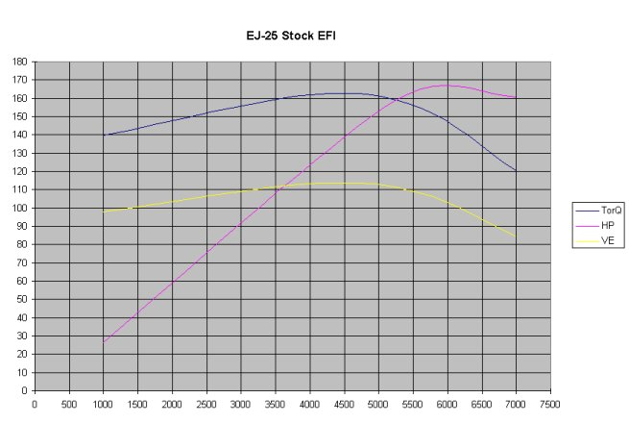
SUBARU DYNO CHART 4 Cylinder
6000 engine RPMs @ 2.179:1 = 2754 RPMs at the Propeller

Slide 22
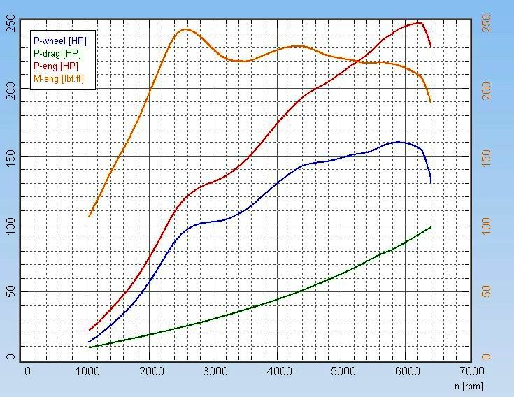
SUBARU DYNO CHART 6 Cylinder

Slide 23
GEAR RATIO’s
The BW350 only comes in one gear ratio. As shown earlier, this drives the engine requirements .
The 200Z comes in many gear ratios. So things like propeller choice, turbo or naturally aspirated, airframe, and performance goals can be used to tailor the gear ratio that achieves the best compromise.
Because the 200Z has a zero vertical offset from the crankshaft it works well with flat opposed engines like the Subaru 4 & 6 cylinder engines. Calculations and flight testing has shown that 2.16:1 to 2.28:1 ratios covers 90% of these installations.
It will also work well with Mazda Rotary engines. These engines turn up to 8000rpm and require gear ratios in the 2.91:1 to 3.03:1 range
The WWI Replica’s also like it for adapting Ford and Chevy inline 6 engines. Due to the large diameter wooden propellers they also require about 1.91:1 gear ratio.

Slide 24
FUEL and OIL CHEMISTRY
Synthetic engine oil is not compatible with leaded fuels!
If you are always, 100%, going to use auto unleaded gas then any of the synthetic engine oils will work fine.
If you run any 100LL Avgas you can not use synthetic engine oil.
Synthetic engine oils can not disperse the lead additives and by products they produce in the combustion cycle. These turn into a thick gray sludge that quickly accumulates in the bottom of the oil pan which will restrict oil from being pulled into the oil pump and cause lubrication failures.

Slide 25
FAA REQUIREMENTS
Wiring Harness – Change from Nylon & Vinyl to all Teflon insulated wire.
Teflon has increased melting and burn temps
Nylon & Vinyl out gases deadly toxins like fluorine gas
Currently this is the only FAA required change that we have run into.
Some FSDO’s and inspectors encourage using an oil filter that can be safety wired.

Slide 26
Other Information
Coil Pack Fuses – one for each individual coil pack
Factory wire harness uses one fuse for all 8 coil packs
Dual ECU’s – A/B switch (probably not needed)
Dual Spark Plugs? – will run as an I-4 (all 4 in one bank) or on just 3 cylinders across both banks. (not needed)
Mechanical Throttle Body – this required by the CAA in Canada. Only aftermarket ECU’s will support these.
Diesels? – 10K alt limit but Jet A fixes that, weight and torsional vibrations are much higher.
Diesel fuel and Jet A is more common in 2nd and 3rd world countries

Slide 27
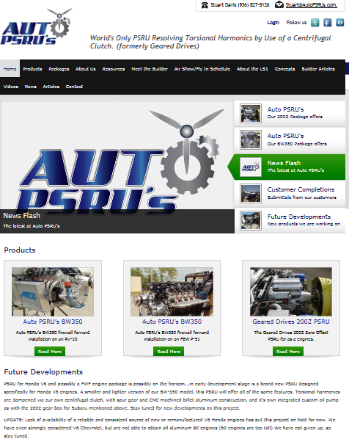
Auto PSRU’s Home Page www.autopsrus.com

Slide 28
CONTACT INFO
Website: www.autopsrus.com
email: stuart@autopsrus.com
Phone: (936) 827-5126
email: blank subject = delete
(spam or security risk)

Slide 29
QUESTIONS & ANSWERS
EXCLUSIONS:
Politics
Taxes
Weather
Religion

