Slide 1
What Keeps it Running Cool
Or Keeps it From Getting Too Hot

Slide 2
The Big Picture
Automobile engines adapted to aircraft use generally are run a little harder for longer periods of time than in a car.
The engine installation in the cowling can be just as tight as in a car, or tighter.
You don’t have an entire department of thermal and aero dynamic engineers to solve heat issues.

Slide 3
Where does the heat come from, and go?
Modern internal combustion gasoline engines convert only 25% to 30% of the heat to usable power. Combustion temperatures can be up to 4500⁰ F.
The balance, 70% to 75%, is heat lost through the cooling system and the exhaust.
This lost heat dissipated is split roughly 50/50 between the cooling and exhaust systems.
Any inefficiencies of the cooling system or exhaust results in higher temperatures under the cowling and in the engine.

Slide 4
The Two Systems to Optimize
First – the exhaust system.
Second – the cooling system.
In both systems its all about keeping flow rates as high as possible.

Slide 5
The Exhaust System
The exhaust system is basically just the exhaust manifold and exhaust tubes.
The primary considerations are to keep it light weight and keep the heat away from sensitive structure and components.
But there are several details that can enhance its performance and life, or make for a miserable and expensive experience.

Slide 6
Exhaust System Components
Exhaust Manifolds
Ditch the stock cast iron manifold. They are heavy, restrictive, and retain too much heat.
Replace it with a good set of quality headers. They are usually one third to half the weight, reduce back pressure, flow more hot gases out which reduces the heat load inside the cowling.
The Good ones
Get the stainless steel version and have them ceramic coated, inside and outside. The coating on the inside improves gas flow and reduces heat transfer. The coating on the outside protects and reduces heat transfer too.

Slide 7
Exhaust Manifold (continued)
The Bad ones
Don’t use cheap mild steel headers. They will rust out quickly and on the inside this will reduce gas flow and increase heat transferred to where you don’t want it.
Don’t wrap the headers with thermal tape. It adds weight and tends to “cook” the metal leading to embrittlement and fatigue/cracking problems. It will also retain moisture increasing corrosion cutting the life of the headers in half or less. The thermal wrap can also hold any leaking oil or gas creating a fire hazard.
If structure or components need heat protection it is better to put thermal wrap, barriers, or shields on them. *
* There are exceptions to this as each installation will have unique requirements.

Slide 8
Exhaust Tubes
The Good ones
Make sure that they are the proper size for your engine and routed as far away from structure and components as possible.
Have them mandrel bent or CNC bent with smooth non-restrictive bends.
Get the stainless steel version and have them ceramic coated, inside and outside. The coating on the inside improves gas flow and reduces heat transfer. The coating on the outside protects and reduces heat transfer too.
Have any joints in the tubing welded. This reduces internal turbulence maintaining good performance and heat flow.
Have them ceramic coated too for the same reasons above.
Use an X-pipe or cross-over pipe if space allows. This also improves performance by balancing gas pulses, improving gas flow, reducing heat and noise, and sounds really good.

Slide 9
The Exhaust Tubes (continued)
The Bad ones
Don’t use cheap mild steel tubing. They will rust out quickly and on the inside this will reduce gas flow and increase heat transferred to where you don’t want it.
Don’t use exhaust clamps. This adds weight and the turbulent joints reduces gas flow increasing heat.
Don’t wrap the exhaust tubes with thermal tape. This tends to “cook” the metal leading to embrittlement and fatigue problems. It will also retain moisture increasing corrosion cutting the life of the headers in half or less. The thermal wrap can also hold any leaking oil or gas creating a fire hazard.

Slide 10
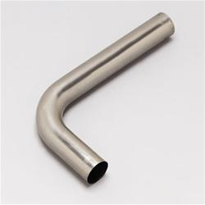
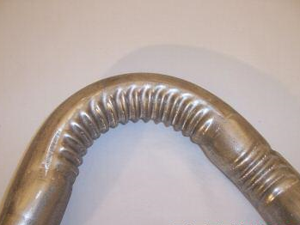
Mandrel/CNC Bent Crush Bend
Smooth
Non turbulent
Rough
Very turbulent

Slide 11
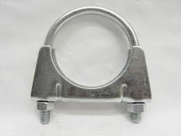
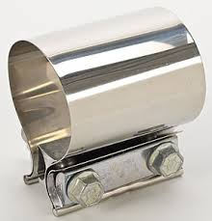
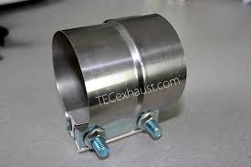
The Exhaust Clamps
The Bad ones
These are heavy and cause flow restrictions from crimping the pipes.
The Good ones
These are lighter and don’t crimp the pipes making removal and reinstallation for maintenance, etc., very easier.
Use dual bolt clamps
Don’t use single bolt clamps

Slide 12
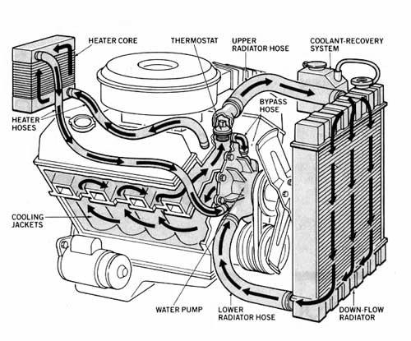
The Cooling System

Slide 13
Cooling System Goals
Keep the coolant flow rate up. Reducing the flow rate does not increase overall heat transfer.
Keep air flow through the radiator up. Too many tubes or fins per inch will restrict air flow too much and reduce heat transfer.
Size the radiator correctly.
Size the air inlet and outlet correctly on each side of the radiator.
Consider the overall design of the system so all components work well together as a system.

Slide 14
Cooling System Components
The cooling system is basically just the radiator, hoses, pump, and fluid.
The primary considerations are to keep the fluid moving through the system, transfer the required amount of heat, and keep it reliable.
Again, there are several details that can enhance its performance and life, or make for a miserable and expensive experience.

Slide 15
The Radiator
Considerations are;
Types – Down Flow or Cross Flow
Materials – Brass/copper or Aluminum
Requirements – Must flow coolant at a minimum rate and transfer a minimum amount of heat
Configurations – Single Flow, Dual Flow This can be a tricky choice

Slide 16
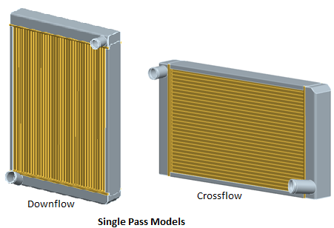
Radiator Configurations (tube orientation)

Slide 17
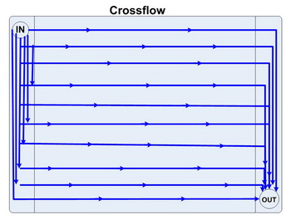
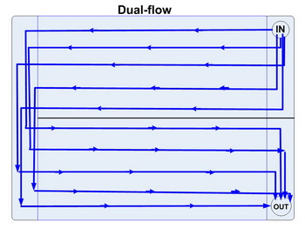
Cross Flow Radiator Types
Single Cross Flow
Dual Cross Flow
Divider
Plate in
Header
Tank

Slide 18
The Radiator Doe’s and Don’ts
Do’s
Stick with dual core (two rows of tubes). These are lighter, are thinner requiring less mounting space, and flow more air.
Keep vertical tube spacing between 0.60 and 1.0 per inch and fin spacing between 15 and 18 per inch to maintain good air flow.
Use “turbulent” flow tubes to maximize heat transfer.
Shroud (baffle) the back of the radiator can double air flow.
Don’ts
Stay away for triple core (three rows of tubes). These are heavier, thicker, and require more vertical spacing between tubes and fins to maintain adequate air flow reducing the total heat transfer.
Resist the temptation to reduce vertical tube spacing (more tubes) and fin spacing (more fins). This reduces air flow through the radiator quicker than any gains in heat transfer.
Converting a single cross flow radiator to a dual cross flow radiator will increase the internal drag reducing coolant flow.

Slide 19
Why Converting radiators from single to dual cross flow doesn’t always work well
The header tank may not be thick enough to re-weld after cutting it.
The divider plate can not be sealed to the core header plate resulting in leakage and reducing the desired results.
Because the coolant has to flow twice the distance through a dual cross flow radiator they will typically have 1.25” wide tubes to maintain the same flow rate. Single cross flow radiators typically use 1.00” wide tubes. Adding a divider plate in a stock single pass radiator results in at least a 33% increase in resistance for going twice the distance which is a 33% plus decrease in flow, and at least 33% less heat transfer. That’s a lot of work and risk to end up with a hotter engine.

Slide 20
Radiator Sizing
AREA – Basic are sizing is 1.2 to 1.5 square inches of maximum horsepower rating. 400 horsepower needs 480 to 600 total square inches of fin area, without the header tanks. Dual radiators would be 240 to 300 square inches each.
VOLUME - Minimum of 3.0 cu in of cooling volume per HP produced. For example: Up to 400 HP of an LS3 for aircraft use. Using a dual radiator configuration with two radiators measuring 15” x 20” x 2.25” thick = the total cooling volume is 1350 cu in. Therefore, our cooling volume to HP ratio: 1350 cu in cooling volume ÷ 400 HP = 3.375 cu in per HP. With this formula, we have been able to maintain climb out temperatures of around 200°F and 190°F at cruise on a 100°F day. With a cooling system like this, we could taxi from Houston to Dallas with no overheating problems.

Slide 21
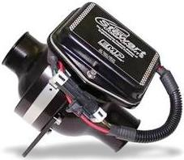
Other cooling system considerations
Water pumps
Stock water pumps flow 8-10 GPM at idle, and 90-100 GPM at high rpm.
Decreasing the water pump pulley to crankshaft pulley ratio will increase this flow, but the main problem is during ground operations when the heat load is high and engine RPM is low.
Replacement electric water pumps flow 80-110 GPM always.
Adding a free flowing in-line electric water pump controlled by a switch (manual or thermal) is better. When off it won’t inhibit the flow of the mechanical pump. When on it flows 55 GPM. This can solve over heating problems during ground operations, plus act as an emergency backup to the mechanical pump if the drive belt breaks.
EMP/Stewart Components E558ABK

Slide 22
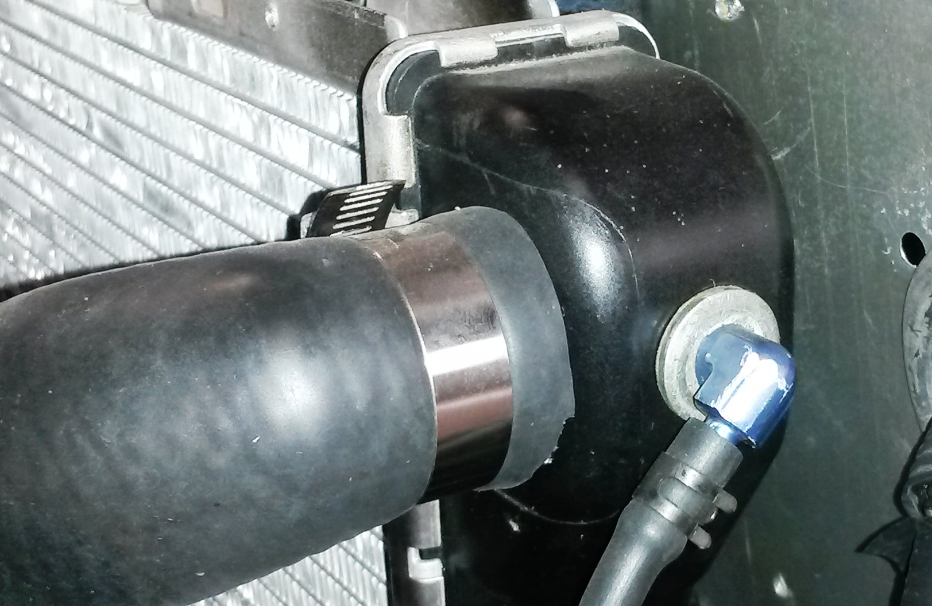
Other cooling system considerations (cont)
Steam Ports
Modern aluminum engines have “steam ports” that vent steam from potential areas where steam can occur. These must be connected to the top of the radiator header tank on the opposite side from the pressure cap.

Slide 23
Other cooling system considerations (cont)
Radiator Fans
Electric radiator fans can reduce or eliminate over heat problems caused by large amounts of engine idle time on the ground.
Inlet and Outlet areas.
The total inlet area should be 0.1 to 0.12 In2 per horsepower.
(400 HP = 40 to 48 in2)
The total outlet area should be 1.8 to 2.0 times the size of the total inlet area.
(40 to 48 in2 on the inlet = 72 to 96 in2 on the outlet)

Slide 24
Other cooling system considerations (cont)
Radiator Caps
Stock radiator caps are usually only 15 to 16 psi. Use a 20 to 24 psi radiator cap if you can. One psi increase raises the boiling point 2 degrees F. Good quality aluminum radiators can handle up to 30 psi.
Thermostats
Stock thermostats are usually 180F to 190F and fail in the closed position. Change this the lowest rated heat you can get (160F) and use a “fail pass” design that fails in the open position. A “fail pass” thermostat is a one time failure part designed to be sacrificed to save the engine. After an over heating event causes the thermostat to go into the “fail pass” position it can not regulate the coolant temperature anymore and must be replaced.

Slide 25
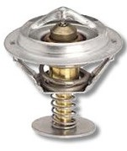
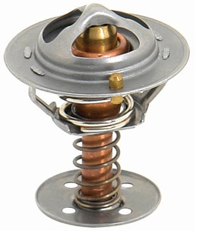
Why “fail pass” thermostats don’t exist for
LS Engines
In the old coolant system a thermostat failure would cause the engine to over heat and blow the radiator cap. In an engine made of cast iron you call AAA and get the thermostat replaced.
In an all aluminum engine major warping and other damage can happen. So GM redesigned the coolant flow to prevent a failed thermostat from blocking the flow of coolant 100%. In addition, if the temperature of the engine starts to get too high the ECU will restrict the power output to control the heat load.
Below are stock (on the left) and performance (on the right) thermostats
The major difference is in the four holes in the bottom disk. This will cause the engine to take longer to warm up, but is added insurance against over heating.

Slide 26
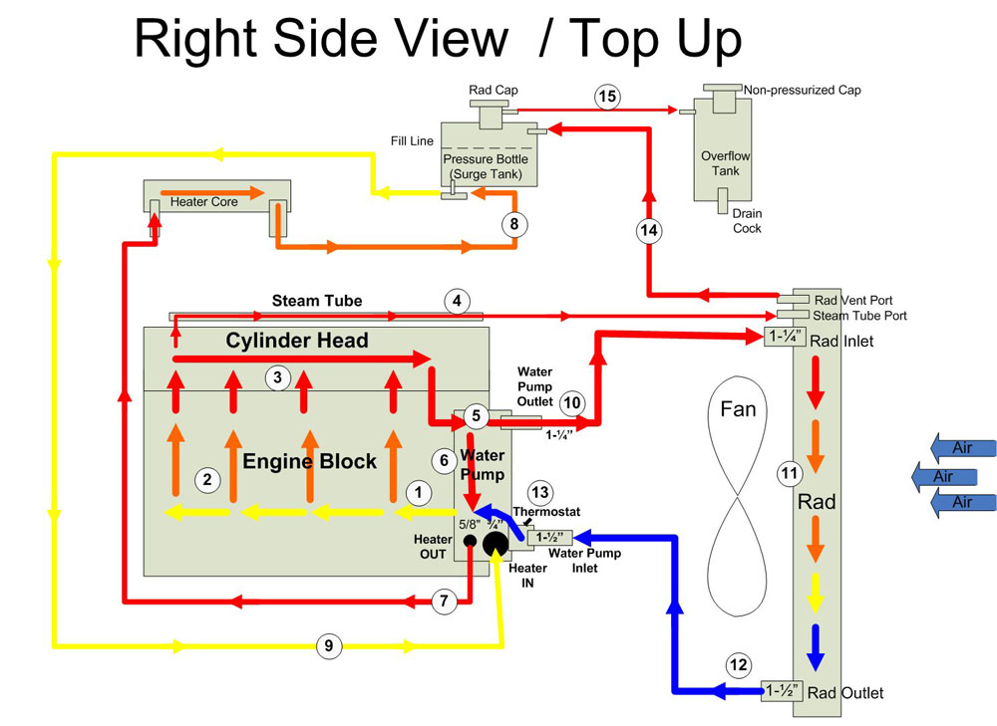
LS Engine Coolant System Diagram and Discription

Slide 27
Starting at the water pump and following the numbers in sequence, here's the flow of the system:
1. The water pump pumps coolant out of the lower two ports on its back side and into the block.
2. Coolant circulates through the engine block...
3. ... and through the cylinder heads.
4. Special LS-specific "steam tubes" or "engine vent lines" are installed on top of the cylinder heads. As vapor or steam will always seek the highest point, any steam pockets created by local hot spots, particularly in the cylinder head exhaust valve area, will migrate up and into the steam tubes which will carry them and a small amount of coolant away and either into a port located at the top of the radiator (as shown here) and from there to the surge tank, or directly to the surge tank (depending on application) where the steam is separated from the coolant.
5.Coolant returning from the cylinder heads enters the two upper round ports on the left and right back sides of the pump
6. Some coolant circulates through the water pump's bypass circuit and is again pumped back through the engine. This keeps the circuit flowing when the thermostat is closed.
7. Hot coolant exits the smaller, rear "heater out" port of the thermostat housing on the water pump. This takes it to the heater core. The port is 5/8" ".
8. After exiting the heater core, coolant returning from the heater passes through the surge tank to keep coolant circulating through that tank.

Slide 28
9. After passing through the heater core and then the surge tank, coolant re-enters the engine via the larger, front 3/4" "heater in" port of the thermostat housing on the water pump.
10. Hot coolant exiting from the engine that doesn't follow the pump's internal bypass circuit exits the water pump via the top 1-1/4" port and enters the top of the radiator. Hot coolant flows across and down through the radiator, cooling as it goes. Cooled coolant exits the radiator via the lower 1-1/2" outlet and returns to the inlet side of the water pump. Returning coolant is blocked from re-entering the water pump inlet if the thermostat is closed. When the coolant on the inside (engine side) of the thermostat reaches the temperature of the thermostat (e.g. 190° F) the thermostat opens and the cool coolant enters the water pump inlet to be circulated through the engine again, starting over at #1.
11. A radiator bleed or vent port located at the top of the radiator connects to the surge tank. Any air or steam in the system, especially that coming from the engine's steam tubes, will naturally seek the highest point and will therefore exit the radiator via this port and travel to the surge tank. At the surge tank, coolant and steam enter and the steam or air is separated from the coolant. The lighter steam / air collects and remains in the surge tank at the highest point, just below the rad cap, to be eliminated first in the event the rad cap purges.
12. The cooler, denser coolant goes to the bottom of the surge tank where it is collected by the flow returning from the heater core and circulated back through the system.
13. In the event of a system over-pressure condition, the rad cap opens and burps excess coolant and steam out of the system to be collected by the overflow tank.

Slide 29
Coolant Choices
Pure (distilled) water is the best at transferring more heat in the lab, but has a higher freeze point, lower boiling point, no lubricant for the water pump, no corrosion control, or any additives to improve wet-out or hot spots.
A 30% to 50% ratio of anti-freeze to water mixture is the best overall compromise for corrosion control, water pump lubrication, lower freezing point, higher boiling point, improved wet-out, and reduced hot spots.
The new Evens Waterless synthetic coolant promise to improved corrosion control, lubrication, lower freezing point, higher boiling point, best wet-out, eliminates hot spots (no steaming), and is more EPA compliant.

Slide 30
Synthetic Antifreeze vs Traditional Antifreeze
Evens Waterless Ethylene/Propylene Glycol
(50/50 mix)
Freezing/Boiling Points: -40F / +375F vs -35F to +265F
Corrosion /Erosion : None vs Yes
Lubrication: Better vs OK
Service Time: Life of Engine vs 2 to 3 years
Toxicity: Less vs More
EPA: More compliant vs Non-compliant
Steaming: None vs Yes
System Pressures: 0 psi vs 16 to 24 psi
(Less wear and tear on hoses, radiator, pumps, etc.)
Heat Transfer : Less vs More
(May require 5% to 10% larger radiator volume – see page 20)

Slide 31
No Steaming means:
No overheating boil-over, especially during high loads or hot shut downs.
No cavitation in the pump or anywhere else in the system.
No hot spots that can cause distortions, warping, or pre-ignition.
Equals higher BHP from eliminating pre-ignition and detonation caused by overheating - thus improving combustion efficiency and delivering more power.
Disadvantages:
Older systems have to be flushed out with a “neutralizer” and then blown out until it passes a PH test.
Costs more up front. - For new engines pays for its self after about two changes of ethylene glycol. - For converted engines it pays for its self after three changes.
Thermostat controlled switches for fans/pumps need to be replaced with new ones that are set at a slightly lower temperature.
Can never have water or ethylene glycol added to it.*
* Water can be added for emergencies, but must be flushed out and system redone.

