Slide 1
1) Updated Flywheel Finger Mounting Design 2) New Engine Conversions and FWF Packages 3) New Facilities and Location
THE LATEST DEVELOPMENTS AT AUTO PSRU’s

Slide 2
UPDATE GOALS:
Change how the Flywheel Fingers are installed to correct the following issues.
Currently the Finger Mounting Bolts go through the back side of the Flywheel and thread into the base of the Fingers.
The flywheel must be bolted to the crankshaft first followed by the rest of the clutch assembly parts.
This causes limited access to the bolt head creating installation and maintenance issues.

Slide 3
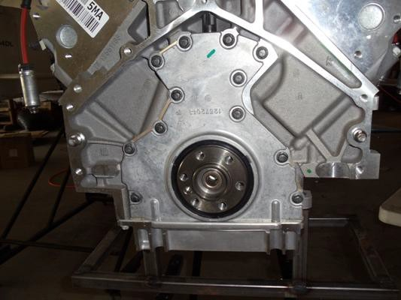
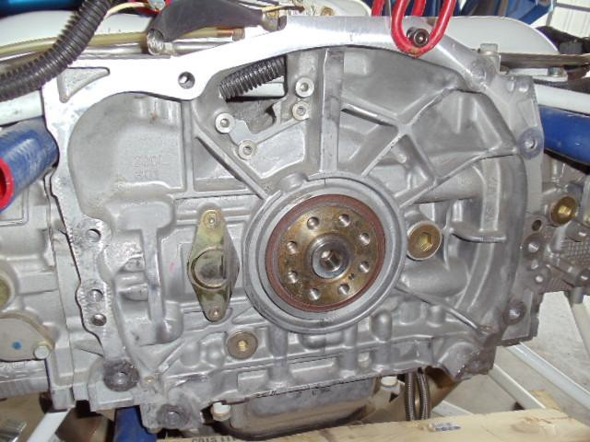
Old Finger Bolt Access
On the LS V8 engines the only access is in the corner circled. This is where the starter is mounted and it must be removed.
On the Subaru the only access is through this hole and the crankshaft position sensor must be removed, with additional obstructions behind it.

Slide 4
Issues to solve
The head of the bolts can only be accessed one at a time by removing engine parts and rotating the flywheel to line up the bolt with the access area.
The Allen Head of the bolt is limited in torque. Any miss-alignment issues with the allen wrench during assembly or disassembly, or rust developing between the bolt head and flywheel makes it too easy to strip out the socket in the bolt head.
The countersink in the flywheel for the flat head bolt creates a thin point at the edge of the starter ring.
The close proximity of the bolt head to the inside edge of the starter ring for the LS V8 flywheels requires machining the bolt head to a smaller diameter.

Slide 5
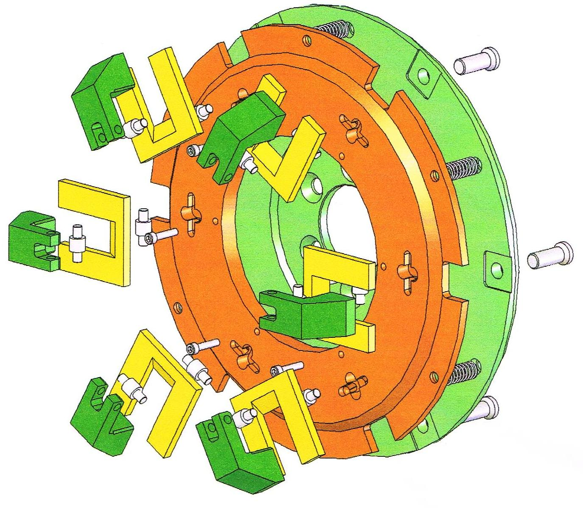
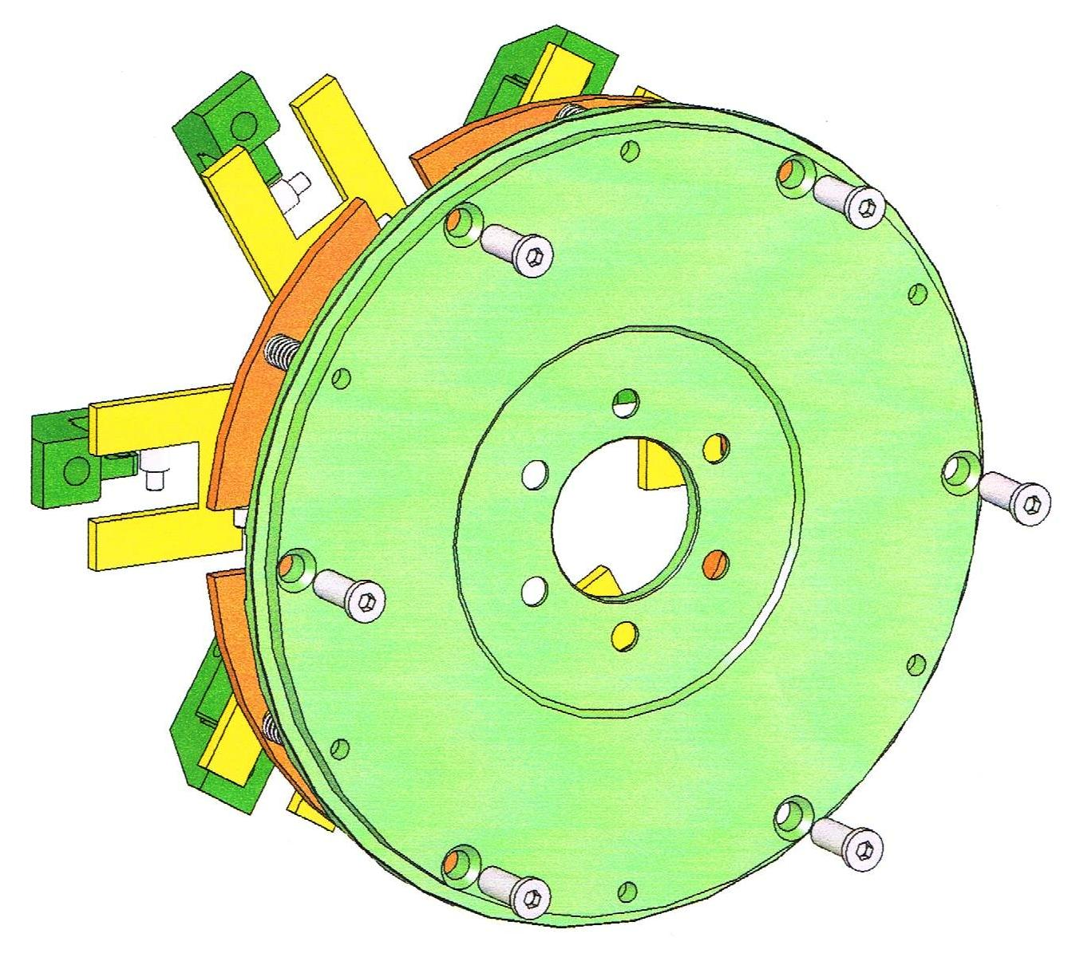
Bolts installed from back side of flywheel. Limited access makes them difficult to install and remove.
Thin spot at edge,
BW350 only

Slide 6
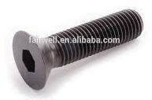
Redesign the mounting of the Flywheel Fingers to the Flywheel
Instead of Flat Head Bolts with Allen Socket heads inserted from the back of the flywheel use 12 Point Flange Bolts that are inserted from the top of the flywheel fingers.
Required changes:
Replace holes and tapers for flat head bolts in the flywheel with threaded holes for the bolt. This eliminates thin spot next to starter ring and uses a smaller bolt resulting in a stronger hole.
Redesign Flywheel Fingers for new bolt head to mount from top instead of bottom of the finger.
Current style bolt
(before machining edge of head)
New style bolt

Slide 7
Test Criteria
Use BW350 loads as basis of test. These loads are 47% higher than the 200Z loads due to heavier weights and larger rotating radius.
Test rig must simulate actual part configuration, wedge angles, and dimensions.
Minimum load for passing test must be equivalent to 6000 RPM, or 2925 pounds.
No yielding, bending or other deformation allowed below 6000 RPM. (3600 prop RPM on BW350)
After passing the minimum loads increase until first signs of any failure.

Slide 8
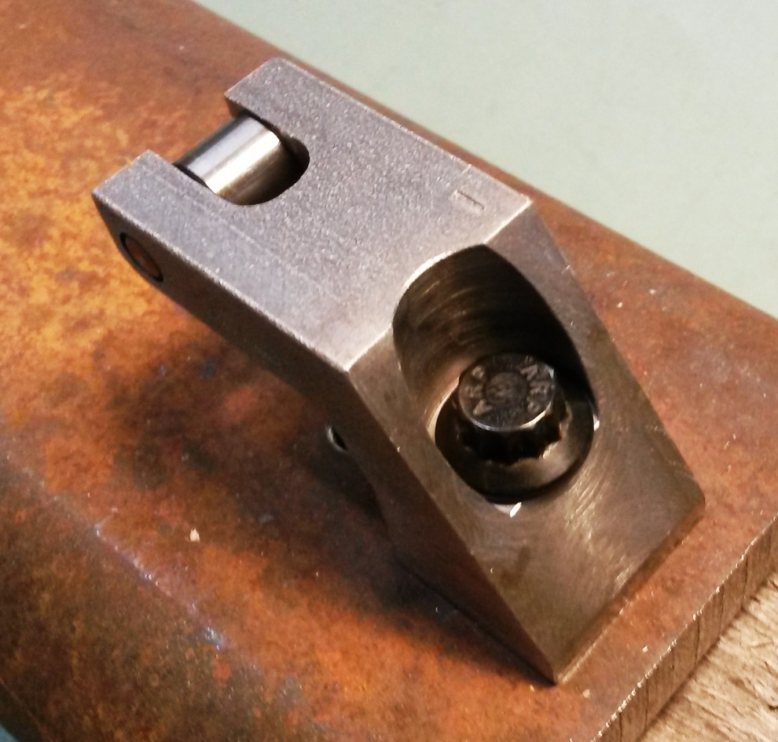
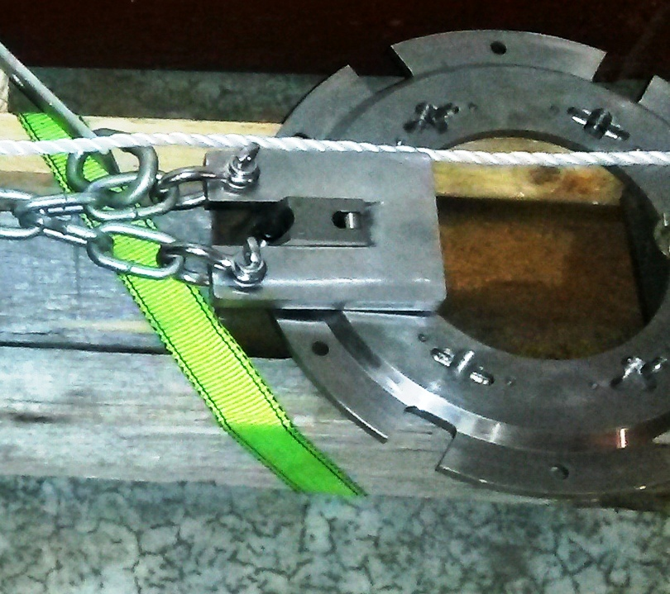
Test Set Up
The test base is the same steel as the flywheel.
A calibrated scale was used to measure the loads applied.
A larger and longer extra strong “weight” was made to pull on.

Slide 9
Predicted Loads
Test Goal,
Max Engine RPM
Max Take-off RPM
Predicted
Bolt
Failure
Test Ended
Loads
Generated
Lbs
4500
6000
7108
7750
Engine RPM’s

Slide 10
Test Results
The maximum load applied was 4130 pounds, equivalent to 7108 RPM.
At this load parts of the test equipment started to yield so the test was stopped.
The analysis predicted that the bolt would start to bend at 7750 RPM equivalent to 4874 pounds.
Upgrading test equipment beyond 5000 pounds would be required to verify the predicted bending failure.
Testing went 2600+ RPM beyond take-off RPM, and 1100 RPM beyond engine limitations – successful test.
Updated parts are currently running on the test/demo stand.
Examples of old and new finger parts are on display.

Slide 11
Key Implications
Initial installation of clutch assembly is much easier.
Proper shimming of the starter to the flywheel is now very easy.
Annual inspections and maintenance are easy with out fear of damage to bolts and/or flywheel.
Adaptation of the clutch and pressure plate to other engines with unique flywheels is now very easy.
All diesel engines use unique dual mass flywheels. This will make it easier for us to convert dual mass flywheels used with the Subaru EE20 and other diesel engines.

Slide 12
Production Status
With all of the design goals met all future Flywheels and Flywheel Fingers will be based on this new design. This update, like many others listed on the following pages, will not increase production prices.
Older Flywheels and Fingers can be modified to this new configuration. Cost to modify earlier fingers and flywheel plus new bolts will be $900 plus S&H.

Slide 13
Other Services Available
Balancing of the Flywheel/Pressure Plate assembly is $150 (for either gearbox). This allows for dynamic balancing of propeller on the aircraft.
Other repairs, parts, up grades, resurfacing, etc. are extra. Call or email for pricing.
Cost of S&H is extra.

Slide 14
List of Improvements Since 2012
Added input shaft and propeller shaft seal retainers.
Solved oil foaming with testing of 4 lubricants and 3 oil filters with new factory recommendations.
Relocated breather to improve case ventilation. Then refined the locations allowing increased oil capacity for better cooling and reserve oil margins.
Improved pressure plate design to increase RPM limits for safety margins beyond the RPM limits of propellers .
Upgraded clutch weight material and added protective lubricant coating on fingers eliminating wear and rust for smoother long term clutch operation.
(Items in blue require factory rework.)

Slide 15
List of Improvements to Date
(continued)
Upgraded all seals and O-rings to Viton for greater temperature range and increased wear resistance on shafts. (Increases service life by over 10 times).
Added separate oil fill plugs and drain plugs with high temperature permanent magnets.
Added a dipstick then upgraded to an oil sight tube designed with durable long life materials to easily check oil level visually through the front of the cowling.
Moved oil filter to a new mounting plate eliminating two fatigue points in the old mounting system.
Redesigned flywheel finger mounting method for easier installation and maintenance.
(Items in blue require factory rework.)

Slide 16
Price Changes Since 2011
Under Geared Drives - as of May 2011;
BW350 = $13,500
200Z = $6,500 (introductory price was below cost)
Firewall Forward BW350 w/ LS1 = $35,000
Under Auto PSRU’s - Current;
BW350b costs $15,100 (+$1,600 +12%)
200Za costs $10,100 (+$3,600 +12% from were it should have been)
Firewall Forward BW350b w/LS3 = $39,200 (+$4,200 +12%)
These 12% price increases covered large increases in aluminum for the cases and steel that impacted the cost of bearings, shafts, hardware, etc.
The cost of developing, testing, and implementation of all the design improvements on the previous two pages have been absorbed without any additional price increases.

Slide 17
Even Bigger Developments
New Mazda Rotary Conversion – Firewall Forward Installation
On Display in the Workshop Tent
New Subaru EJ25 and EZ30 Firewall Forward Installations
This new installation design is totally different, its lighter than the Eggenfellner installation, and eliminates it’s propeller wobble.
The first EZ30 for an RV-7A will be on display at AirVenture
All 3 Being Fine Tuned In Our New Facilities

Slide 18
Even Bigger Developments
New Mazda Rotary Conversion
Rebuilt 13B – Non-Turbo or Turbo Normalized.
Updated Seals.
Oil cooler.
Intake and Exhaust Porting & Polishing.
Water Pump and 70 amp Alternator.
ECU Controlled Ignition and Fuel Injection.
Turbo Normalized 200 HP & 190 Tq @ 7,600 RPM to 18,000+ Ft with automatic manifold pressure control.
Non-Turbo 180 HP & 160 Tq @ 7,600 RPM at sea level.
Turbo Normalized turn key wet weight 340 lbs.
Non-Turbo turn key wet weight 300 lbs.

Slide 19
Even Bigger Developments
Subaru EZ30
Cross drilled crank.
Steel head gaskets.
No VVT (Variable Valve Timing).
Inconel exhaust valves.
Stainless intake valves.
Upgraded pistons.
Upgraded oil pump.
Hardened performance bearings.
Upgraded timing chain system.
ECU tuned for aircraft application w/wideband O2 sensor.
230 hp & 230 tq peak power @ 3600 to 4000 rpm with “flat” torque curve*.
EZ30 performance of 230 HP & 230 Ft-lb Tq @ 3600 to 4000* RPM
*Tuning tests on a dyno will determine the final performance

Slide 20
Even Bigger Developments
Subaru EJ25
Cross drilled crank.
Steel head gaskets.
No VVT (Variable Valve Timing).
Inconel exhaust valves.
Stainless intake valves.
Upgraded pistons.
Upgraded oil pump.
Hardened performance bearings.
Upgraded timing belt system.
ECU tuned for aircraft application w/wideband O2 sensor.
150 hp & 170 tq peak power @ 3600 to 4000 rpm with “flat” torque curve*.
EJ25 performance of 150 HP & 170 Ft-lb Tq @ 3600 to 4000* RPM
*Tuning tests on a dyno will determine the final performance

Slide 21
Even Bigger Developments
The Subaru and Mazda parts will be offered three ways:
1) As a 200Za with Engine Adapter Plate – $10,100
2) The engine mounting frame separately – $1,800
3) As a Firewall Forward Package – starting with overhauled engines
Mazda 13B – $28,400
Mazda 13B Turbo – $36,900
Subaru EJ25 – $27,400
Subaru EZ30 – $ 27,600
Above pricing includes any engine core charges. If you have an old engine to use as a core trade-in call us for how much discount its worth.
All PSRU’s and Firewall Forward Packages are tested and thoroughly inspected for successfully passing all tests with at least two hours of trouble free running prior to delivery.

Slide 22
BW350 Special Requests
Occasionally I get requests for special versions of the BW350. These fall into 4 basic categories.
1) Beefed up for aerobatics or racing.
2) Beefed up for huge horsepower increases.
3) Change the gear ratio.
4) Modified for a propeller extension.
Items 1, 2, and 3 require extensive redesign, tooling, and hardware changes. That equals BIG BUCKS and lots of time. How much? One year+ and $200,000+ up front to start.
Item 4 is in work as an option for certain aircraft kits that would benefit from up to a 4” extension.

Slide 23
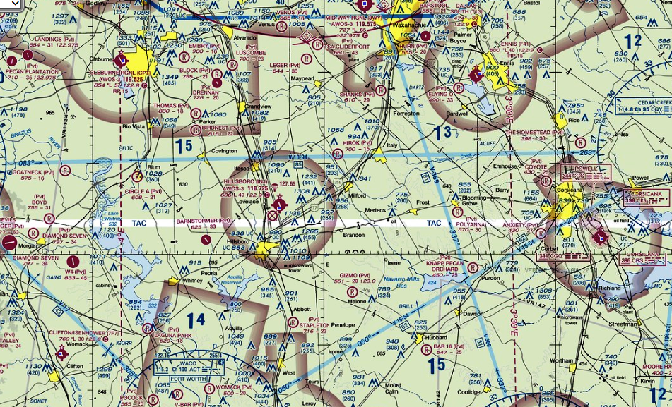
New Facilities and Location
New products and increased demand for current products demanded a larger facility. Searches between the DFW area and Waco resulted in choosing Hillsboro, TX airport. The new address is;
1000 Airport Blvd, Suite 104, Hillsboro, TX 76645
Phone number and website will remain the same.
Hillsboro Airport - KINJ runway is 3998’ x 60’, has 100LL and Jet A, and boasts the lowest fuel prices in the region.

Slide 24
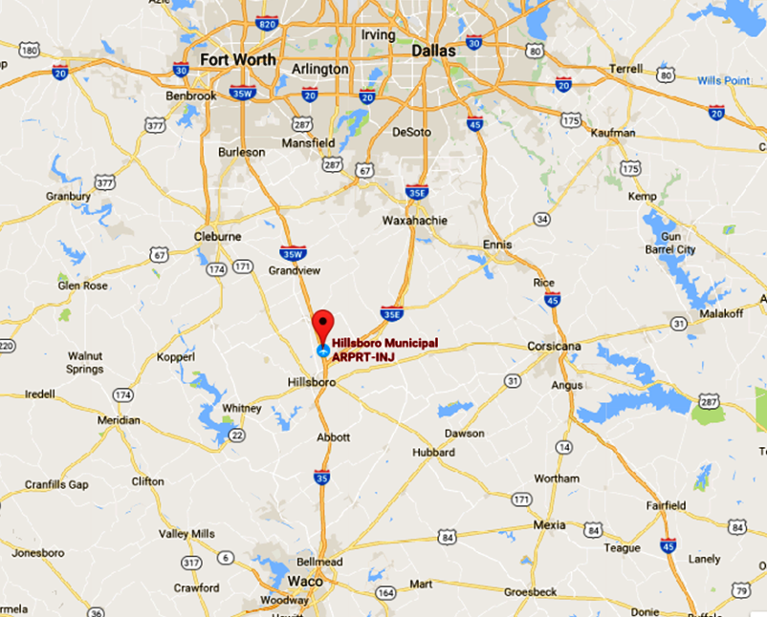
New Facilities and Location
By Car:
Five miles north of Hillsboro, TX, or 30 miles south of Fort Worth, TX, on I-35W via exit #3.
The new hangar is 80’ x 80’ with a
large shop area, storage areas, conference room, restroom, and two offices.
The open hangar area has enough space to work on six+ aircraft and 4 engine stands.

Slide 25
Contacting Auto PSRU’s
By Email;
stuart@autopsrus.com
My original website host sold my email address which still results in over 200 to 300 spam emails or more a day.
Please use a brief subject line about what you are interested in – i.e. “BW350 for RV-10”, “200Z for RV-7”, “LS3 FWF”, etc. Using “Hello” or a blank subject gets tagged as spam.
Despite careful sorting by subject and who emails are from it is quite possible for me to miss your email. If you don’t hear from me within 24 to 48 hours just call or text me that you didn’t get a reply.
The Social Media links on my website do not function.
Other email addresses for me are private. Please use the business email.

Slide 26
Contacting Auto PSRU’s
By Phone;
(936) 827-5126 (business cell phone)
If I don’t answer your call its because my attention and hands are occupied with machining, assembling, testing parts, or I am talking with someone else.
Just leave a brief message. I always try to return voicemail messages within one hour or less.
No voicemail message means to me it was a solicitor calling, so no message means no returned call.
Texting will also work well, and please keep it brief with whole words.
Other phone numbers for me are private. Please use the business phone number.

Slide 27
Information at Sun N Fun
Auto PSRU’s and its staff are volunteers in the Engine Workshop Tent all week.
We are available to answer any of your questions about ANY aircraft engine, issue, installation, conversion, maintenance topic, etc., including certified engines.
If we can’t answer your questions, or think someone else in the Engine Workshop Tent is more qualified, we will direct you to them so you will get the best answer(s) possible.
We are not here as a Vendor. As volunteers we can not take orders for parts, gearboxes, or Firewall Forward packages.
We can give you business cards and/or brochures. You can talk to us after the fly-in, or outside the workshop area.

Slide 28
QUESTIONS & ANSWERS
EXCLUDED TOPICS:
Politics
Taxes
Weather
Religion

