Slide 1
1) Lessons Learned 2) Propeller Size Effects on Shaft Loads 3) New Developments 4) News and Announcements
LESSONS, TIPS, AND NEWS FROM AUTO PSRU’s

Slide 2
LESSONS LEARNED
Water in gas.
2) Oil in intake.
3) Welding around engine.

Slide 3
Water in gas
Water molecules are larger than gasoline molecules, and they do not like going through the small orifices of the fuel injectors.
This makes a gascolator or fuel/water separator filter a mandatory item. It is best to locate this feature between the fuel selector valve and the fuel pump.

Slide 4
Oil in the Intake
Oil, like water, vaporizes when it gets hot. The PCV system will circulate this vapor through the intake and it gets burned. BUT there is a limit to how much vaporized oil an engine can handle!
Excessive amounts oil vapor in the intake can cause major problems with electronic controlled engines. It can cause fowling of sensors and spark plugs. This leads to making it very difficult to start the engine and cause it to run rough.

Slide 5
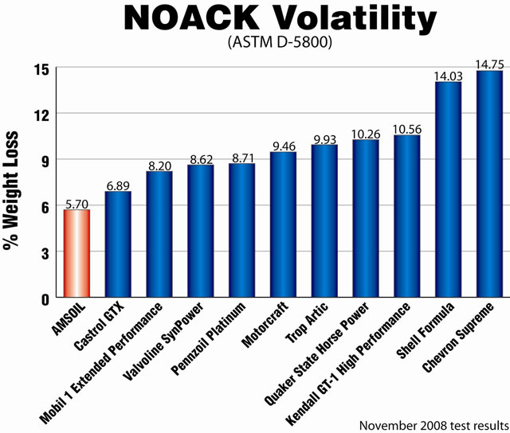
Oil in the Intake
Not all oils are created equal, especially when it comes to their NOACK volatility rating.

Slide 6
Oil in the Intake
The oil previously used in our test stand, for hundreds of hours, was Shell Rotella T5 10W-30. The Petroleum Quality Institute of America (PQIA) NOACK rating for Shell Rotella T5 10W-30 is 13.1.
This resulted in the oil pooling in the intake manifold of the test engine. So much that it was easy to see it slosh around after we pulled the throttle body off. It took 6 soaked Scott Blue shop towels to wipe out most of it.

Slide 7
Oil in the Intake
This was what has caused our test engine to get more difficult to start, run rough until it warmed up, even difficult to re-start warm and reduced it’s performance.
Major effects on the engine were;
The MAP sensor totally failed indicating sea level pressures in the intake. This caused the ECU to run a much richer air/fuel mixture than it should.
The pooled oil was also fowling the spark plugs as it was sucked into the engine causing some of them to short out until after the engine started and ran for a while.

Slide 8
Oil in the Intake
Solution and changes;
Removed and cleaned out the intake manifold
Replaced the MAP sensor.
Did an oil and filter change switching to Castrol GTX synthetic blend 10W-30. This improved the NOACK rating from 13.1 to 6.9.
Added an oil/air separator in the PCV system between the crankcase and intake.

Slide 9
Oil in the Intake
After the ECU went through a few brief learning runs to adjust to the new MAP sensor and lack of error codes there are no more hard starting issues, no more rough running until the engine warms up, and the engines original performance is back.
The air/oil separator has a drain cock with a tube that can be attached to a catch can. After over 20 hours of testing only a small amount of water condensation has been drained out for the oil/air separator. We finally got about 2 table spoons of oil in it after making an unusually hard engine run that lasted 35 minutes.

Slide 10
Welding Around the Engine
Investigating and working with several different engine ECU’s we have noticed the addition of some small print in the installation instructions.
This small print advises not to do ANY TIG, MIG, or Arc welding with the ECU installed in the car.
These systems are designed to run on signals based on low voltages and milliamps. Even though they have built in protections a missing, failed, or improper ground could result in burning them out.

Slide 11
PROPELLER SIZE EFFECTS on SHAFT LOADS
There are two major parameters that impact the propeller loads on the propeller shaft.
Changes in Weight
Changes in Diameter
Flight maneuvers
The propeller shaft of the BW350 uses the same bolt pattern of the IO-540 which is designed to handle a 3-bladed metal Hartzell propeller.

Slide 12
Changes in Propeller Weight
The problem arises from several engines and propellers using the same bolt pattern.
This does not mean that the shaft is designed for all sizes of propellers.
Larger diameter and/or increase in weight can be very bad.
Example: some PT-6 engines use the same bolt pattern used on O-360 and larger Lycomings.
PT-6 propellers were involved in two failures on the BW350 which lead me to investigate the effects of bigger and heavier propellers on propeller shafts.

Slide 13
Changes in Propeller Weight
In general terms the inertia effects of weight and diameter changes can be calculated with some basic equations. Independently they are:
The weight changes in general can be calculated as a 1 to 1 ratio effect for propellers with the same of the number of blades.
The impact of diameter changes can be calculated as a cubed factor of the changed diameter effect for propellers with the same of the number of blades. For a 10% increase in diameter 1.1^3 results in 1.331, or a 33.1% increase.
If both change they can be added together.

Slide 14
Changes in Propeller Diameter
First Case – 3 Bladed PT-6 Prop on Glasair III
Hartzell
Metal
3- blade
Propeller
80 inches
85 lbs
Modified
PT-6
3- blade
Propeller
100 inches
130 lbs
Physical
Increases
Diameter
125.0%
Weight
152.9%
Effect on
Inertia
Loads
^3
1 to 1
Total Impact
Increased
Inertia
Loads
195.3%
x
152.9%
298.6%

Slide 15
Changes in Propeller Diameter
Second Case – 4 Bladed PT-6 Prop on P-51 Replica *
Hartzell
Metal
3- blade
Propeller
80 inches
85 lbs
Modified
PT-6
4- blade
Propeller
110 inches
146 lbs
Physical
Increases
Diameter
137.5%
Weight
164.7%
Effect on
Inertia
Loads
^3
1 to 1
Total Impact
Increased
Inertia
Loads
260.0%
x
164.7%
428.2%
* The increased number of blades increases the impact. For simplicity this is ignored in this example.

Slide 16
Changes in Propeller Diameter
These increases in the inertia loads on a propeller shaft become critical when flight loads (g’s) are combined with them.
Everything may seem fine during ground testing and normal flight, but everything changes as the flight envelop is increased.
In both cases these planes had several hours on them before doing a high speed fly-by with a high G pull-up at the end of the runway. This combination of loads were beyond the load limits of the shaft.

Slide 17
Changes in Propeller Diameter
FUN FACT:
Can you guess what the impact of aerobatic maneuvers (snapping, tumbling, and high speed high-G pull-ups) does to the gyroscopic loads on the propeller shaft (including engine mount, firewall attachments, ect)?

Slide 18
Changes in Propeller Diameter
ANSWER:
According to FAR 23 the gyroscopic loads goes by a factor of at least 1.6.
Case #1 Final impact 298.6% x 1.6 = 477.8%
Case #2 Final impact 428.2% x 1.6 = 685.1%

Slide 19
Changes in Propeller Diameter
From our examinations and pictures of the failed gearboxes the weak points are now very well documented. They confirm the strength analysis and proves the modeling.
This has afforded us the knowledge on how to offer new upgraded versions of the BW350 for customers with more demanding requirements.

Slide 20
NEW DEVELOPMENTS
Propeller Shaft Extension Option
(Up to 4.0 inches)
2) Increasing from Normal to Aerobatic Category
(from 3.8g to 6.0g maneuvers)
3) Dyno Testing
(proof of Horse Power and Torque at propeller)

Slide 21
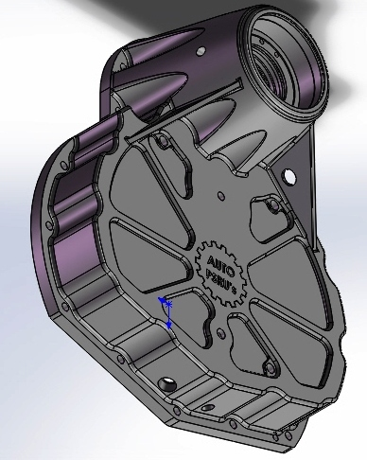
Propeller Shaft Extension Option
This upgrade to the front case allows longer propeller shafts up to 4 inches longer than stock.

Slide 22
Normal to Aerobatic Category
The upgraded front case in the previous slide plus an upgraded propeller shaft and final top gear allows the BW350 to take aerobatic loads.
This is possible using the standard length propeller shaft only, not extended shafts.
A new dry sump type lubrication system is still in development for handling negative g’s.

Slide 23
Engine Dyno Testing
Last year in the Engine Workshop Tent discussions about engine testing lead to the realization that now one sense Javelin Aircraft in the early 80’s has done any engine dyno testing to prove what their engines and/or gearboxes performance truly is.
Everyone modifies their auto engines with at least exhaust headers and aftermarket ECU systems.
Frequently intake manifolds and internal modifications are done too. The results that get published are developers best calculation.

Slide 24
Engine Dyno Testing
Auto PSRU’s ultimate goal is to have our own dyno that can accommodate a wide range of auto engine conversions, propeller flanges, and aircraft engines, mounted on a portable trailer. This will allow for true comparisons to aircraft engines as well as prove what modifications to auto engines works best for aircraft applications.
Until then the search for an engine dyno for hire is an on going effort.

Slide 25
News and Announcements
New Location and Hangar Status
Plymocoupe Replica
Aeromobil Flying Car
Piper PA-25 Tow Planes

Slide 26
New Location and Hangar Status
New products and increased demand for current products required a larger facility. Searches between the DFW area and Waco resulted in choosing Hillsboro, TX airport. As of 06/2018 the new address is;
1000 Airport Blvd, #104, Hillsboro, TX 76645
Phone number and website are the same.
Hillsboro Airport - KINJ runway is 3998’ x 60’, has 100LL and Jet A, and boasts the lowest fuel prices in the region.

Slide 27
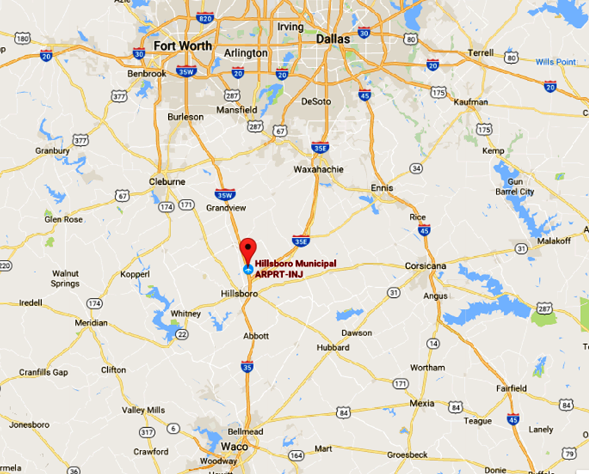
New Location and Hangar Status
By Car:
Five miles north of Hillsboro, TX, or 30 miles south of Fort Worth, TX, on I-35W via exit #3.
The new hangar is 80’ x 80’ with a
large shop area, storage areas, conference room, restroom, and two offices.
The open hangar area has enough space to work on six+ aircraft and 4 engine stands.

Slide 28
New Location and Hangar Status
We finished moving in on June 4th, 2017. The hangar was not 100% completed until August 14th, 2017. On June 4th both sides, the back and only 1/3 of the roof was up.
Starting on March 20th 2018 construction on a new 30 foot wide extension to the airport ramp system was started that will connect the large apron area in front of our hangar to the rest of the airport and runway. (No more bad Gumbo!)
This should be completed by the time we get home from Sun N Fun 2018.
Originally this was scheduled to be done in mid 2019, but the EPA approved the existing airport drainage design marked for upgrading freeing up funds for the ramp extension.

Slide 29
Plymocoupe
Ole Fahlin developed and converted a 1933 Plymouth inline 6 cylinder engine installed in a Monocoupe aircraft called the SF-2 Plymocoupe. He built two aircraft. Both were bought by Germany in 1936 and shipped out. Only one survived the war, less the gearbox, and found it’s way into the Nicholas-Beazley Museum in Marshall Missouri as a future exhibit.
One of the museum volunteers associated with the restoration contacted me at Airventure 2017 and asked if we could build a flying replica of the missing gearbox. I agreed and he has sent us tons of data, pictures, and some limited drawings/loftings to base it on.

Slide 30
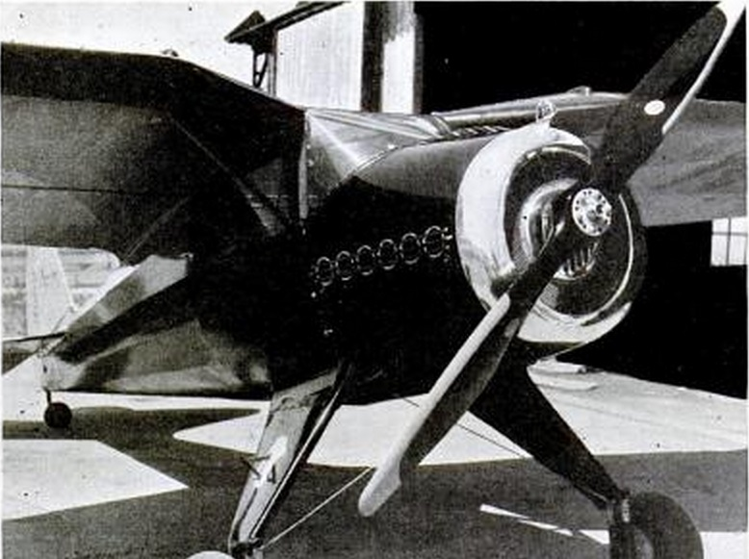
Plymocoupe

Slide 31
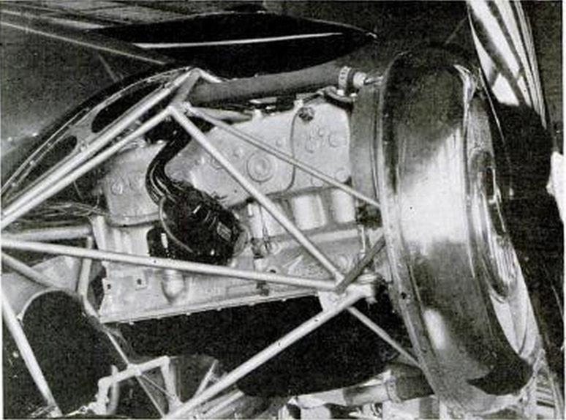
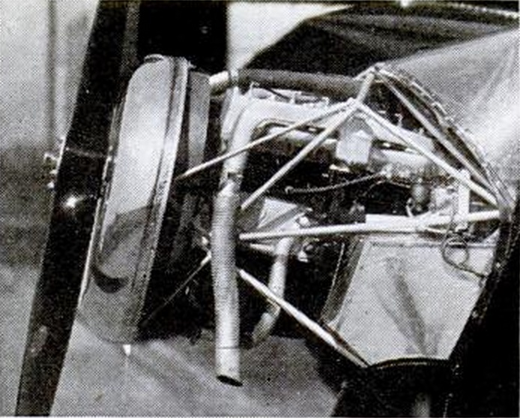
Plymocoupe
Major engine modifications included a magneto, new intake with an updraft carburetor, and new exhaust.
These changes increased the horse power from 80 HP to 100HP @ 3800 rpm.
The CAA certified this engine.

Slide 32
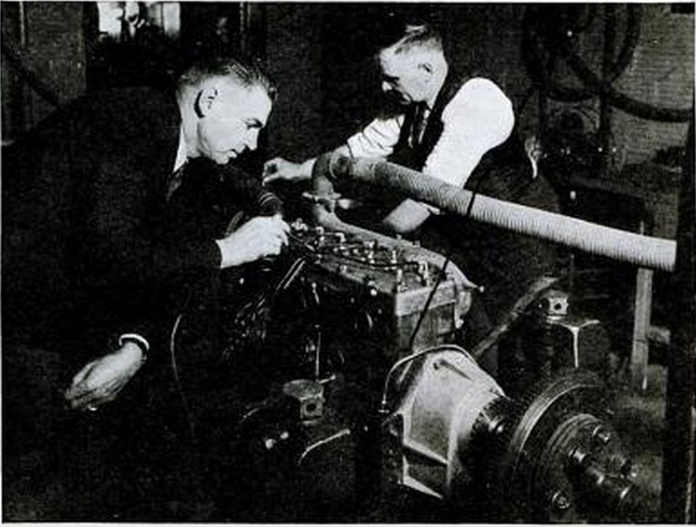
Plymocoupe
Dyno testing of the Plymouth engine proving the HP gains.
The gearbox is visible in this picture had a 2:1 ratio.

Slide 33
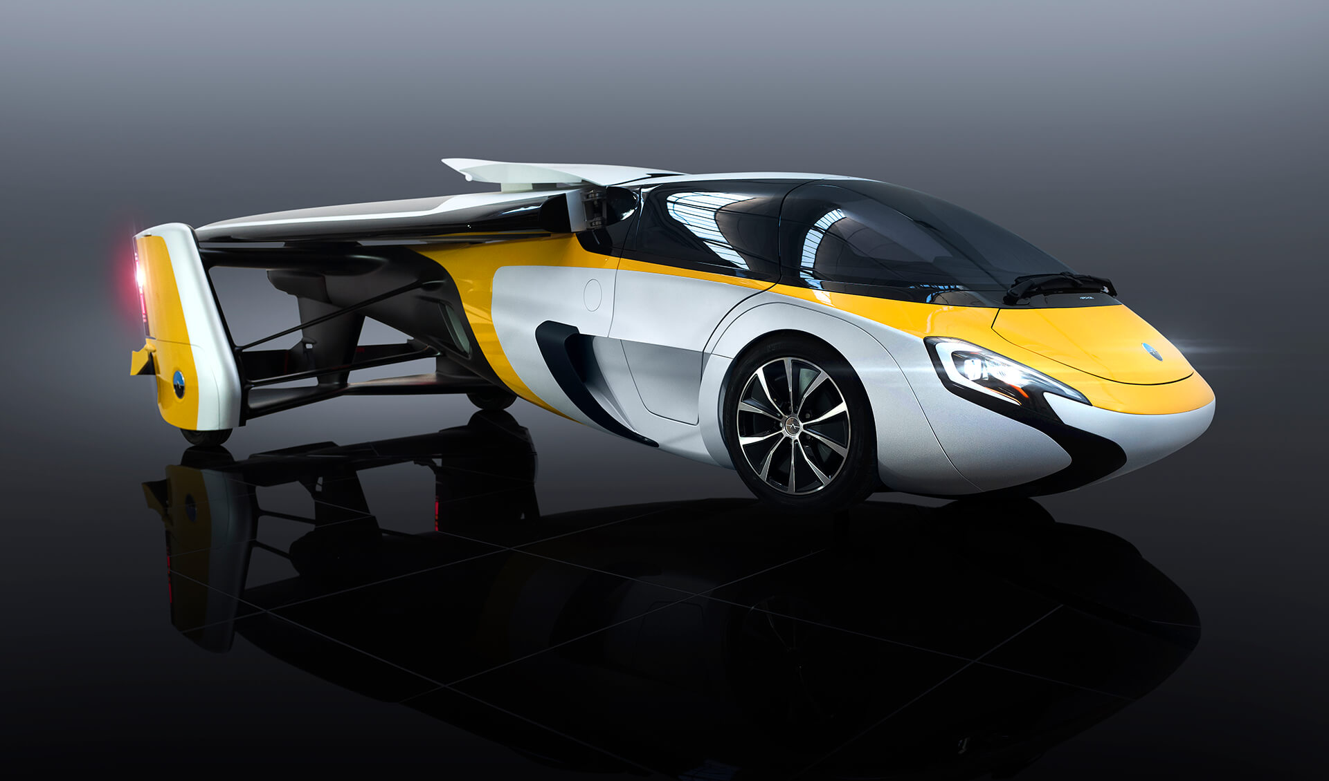
AeroMobil Flying Car
Started in 2010 Aeromobil is currently on Version 4.0
Wings folded – car configuration

Slide 34
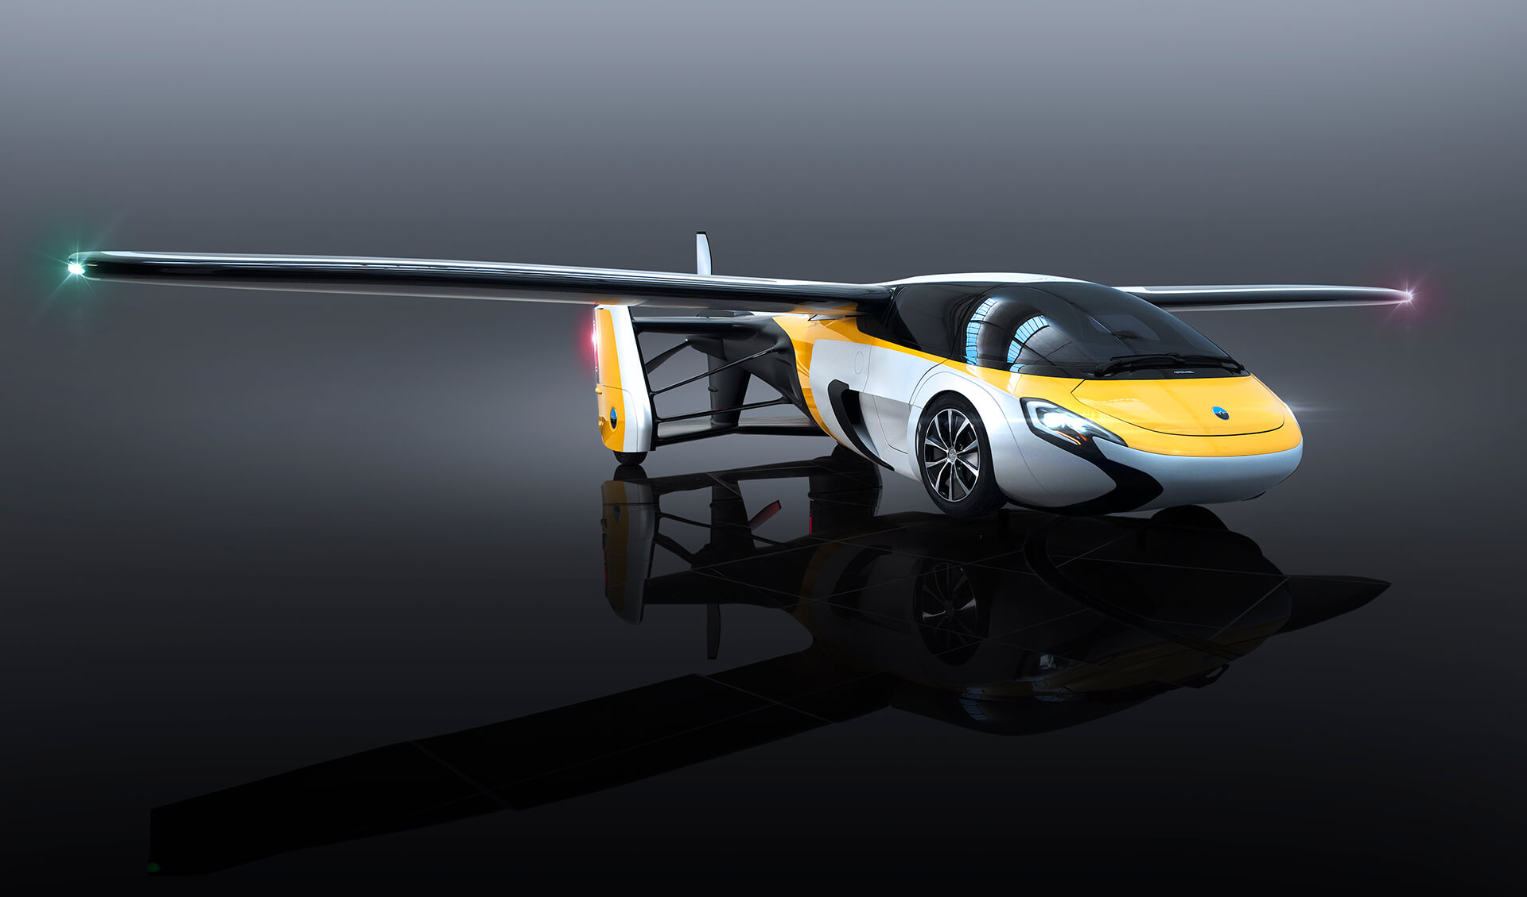
AeroMobil Flying Car
Wings unfolded – airplane configuration

Slide 35
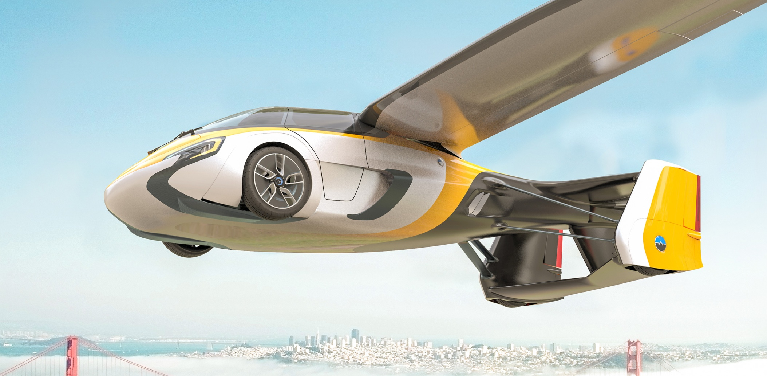
AeroMobil Flying Car
Wheels semi-retract in flight

Slide 36
AeroMobil Flying Car
Wheels extended for driving

Slide 37
AeroMobil Flying Car
Size/Capacity/Weight
Automotive Dimensions – 19’4”L, 7’3”W, 4’11”H
Aerospace Dimensions – 19’0”L, 28’10”W, 4’6”H
Max Take Off Weight – 2116 lb (useable load 529 lb)
Power
AeroMobil custom 2.0L turbo charged 4 cylinder boxer ICE
Dedicated electric front wheel drive with electronic differential
Adaptive transmission for both road-going functionality and direct drive during flight.
Automotive Power – 100 BHP via twin E Motors
Aerospace Power – 300 BHP via Turbo charged ICE (Euro 6)
Direct Drive variable pitch propeller (2,400 rpm)
Overall Power plant weight – 242.5 lb

Slide 38
AeroMobil Flying Car
Operating Range
Automotive Range (estimated using NEDC cycle 0.92gal/62.14mi
Aerospace Max Cruise Range 405nm @ 75% (1,200m, ISA)
Fuel Capacity 23.8 gal
Performance
Automotive – Top speed 99.4 mph, 0-62.1 mph 10 sec.
Aerospace – Vs/Vc/VD – 69.6/160.9/223.7 mph
MTOW Take Off Distance, ground roll/50 ft – 1302.5/1952.1 ft
Safety
Airframe Parachute System
Occupant Restraint Systems – Airbags, Pyrotechnic Load limiting seat belts
Integral Carbon Fiber Structure & Occupant Cell
Autonomous Flight via current autopilot technology (optional)

Slide 39
AeroMobil Flying Car
Key Features
Full transformation into flight mode in less than 3 minutes
Adaptive Flight control surfaces and vehicle suspension for optimal take-off and landing
Advanced controls and avionics in both Fly and Drive modes.
Certification Basis
Automotive: EWVTA/M1 (EU) & 49 CRF 571 (US)
Aerospace: CS 23 Rev5/ELA 1 (EU) & 14 CFR 23 Rev 5 (US)
Wheels
Wheel and tire size front: 165/65/R15 on 15jx6 rim
Wheel and tire size rear: 145/65/R15 on 15jx4.5 rim

Slide 40
AeroMobil Flying Car
Our 200Za PSRU gearbox was selected by AeroMobil as the best PSRU to put between the engine and the propeller drive system for three reasons.
Its horsepower rating for its size and weight
For its customizable gear ratios
Automatic clutch design that controls harmonics
The first 200Z shipped from the Hillsboro hangar on June 6th, 2017. Flight testing is scheduled to start this fall.

Slide 41
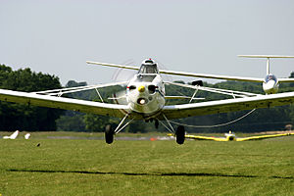
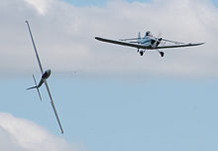
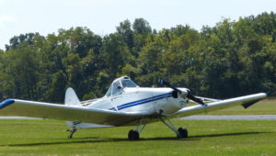
Piper PA-25 Glider Tow Plane

Slide 42
Piper PA-25 Glider Tow Plane
Last year the Souring Society of America in Australia contacted the Australia CASA (FAA) about using converted automotive engines as an economical replacement for the aging Lycoming IO-540’s in all of their PA-25’s.
In response the Australia CASA granted permission for them to use their Limited category for this application.
On December 18th last year I started answering their questions about using our LS3 Firewall Forward package to replace their old IO-540’s.
Last month those discussions moved into negotiations for up to 60 conversions for 20 glider clubs all across Australia. It is hoped that by AirVenture a full contract will be in place.

Slide 43
Piper PA-25 Glider Tow Plane
The Australians like our LS3 Firewall Forward Package for the following reasons.
It’s comparable weight to the Lycoming IO-540
Cost savings over buying new Lycomings of $18,000+
Independent lubrication system
Supports current hydraulic constant speed propellers
The more than 22% increase in horsepower and torque
Reduced fuel consumption by up to 30%
Reduced maintenance costs by up to 80%
Easier to get parts
Cost to rebuild will always be cheaper
Smoother engine – less airframe/pilot fatigue
3000 hr versus 2000 hr TBO reduces $/hr life costs
Ability to burn auto fuel for even more savings
Elimination of engine thermal shock
Completely tested, documented, and proven design

Slide 44
Contacting Auto PSRU’s
By Email;
stuart@autopsrus.com
Please use a brief subject line about what you are interested in – i.e. “BW350 for RV-10”, “200Z for RV-7”, “LS3 FWF”, etc. Using “Hello” or a blank subject gets tagged as spam.
Despite careful sorting by subject and who emails are from it is quite possible for me to miss your email. If you don’t hear from me within 24 to 48 hours just call or text me that you didn’t get a reply.
The Social Media links on my website do not function.
Other email addresses for me are private. Please use the business email.

Slide 45
Contacting Auto PSRU’s
By Phone;
(936) 827-5126 (business cell phone)
If I don’t answer your call its because my attention and hands are occupied with machining, assembling, testing parts, or I am talking with someone else.
Just leave a brief message. I always try to return voicemail messages within one hour or less.
No voicemail message means to me it was a solicitor calling, so no message means no returned call.
Texting will also work well, but please keep it brief using whole words and no emojies.
Other phone numbers for me are private. Please use the business phone number.

Slide 46
Information at Sun N Fun
Auto PSRU’s and its staff are volunteers in the Engine Workshop Tent all week.
We are available to answer any of your questions about ANY aircraft engine, issue, installation, conversion, maintenance topic, etc., including certified engines.
If we can’t answer your questions, or think someone else in the Engine Workshop Tent is more qualified, we will direct you to them so you will get the best answer(s) possible.
We are not at Sun N Fun as a Vendor. As volunteers we can not take orders for parts, gearboxes, or Firewall Forward packages.
We can give you business cards and/or brochures. You can discuss orders after 5pm, after the fly-in, or outside the workshop area.

Slide 47
QUESTIONS & ANSWERS
EXCLUDED TOPICS:
Politics
Taxes
Weather
Religion

